Slide 1
On Covert Channels using QUIC Protocol Headers
David Cheeseman, CISSP

Slide 2
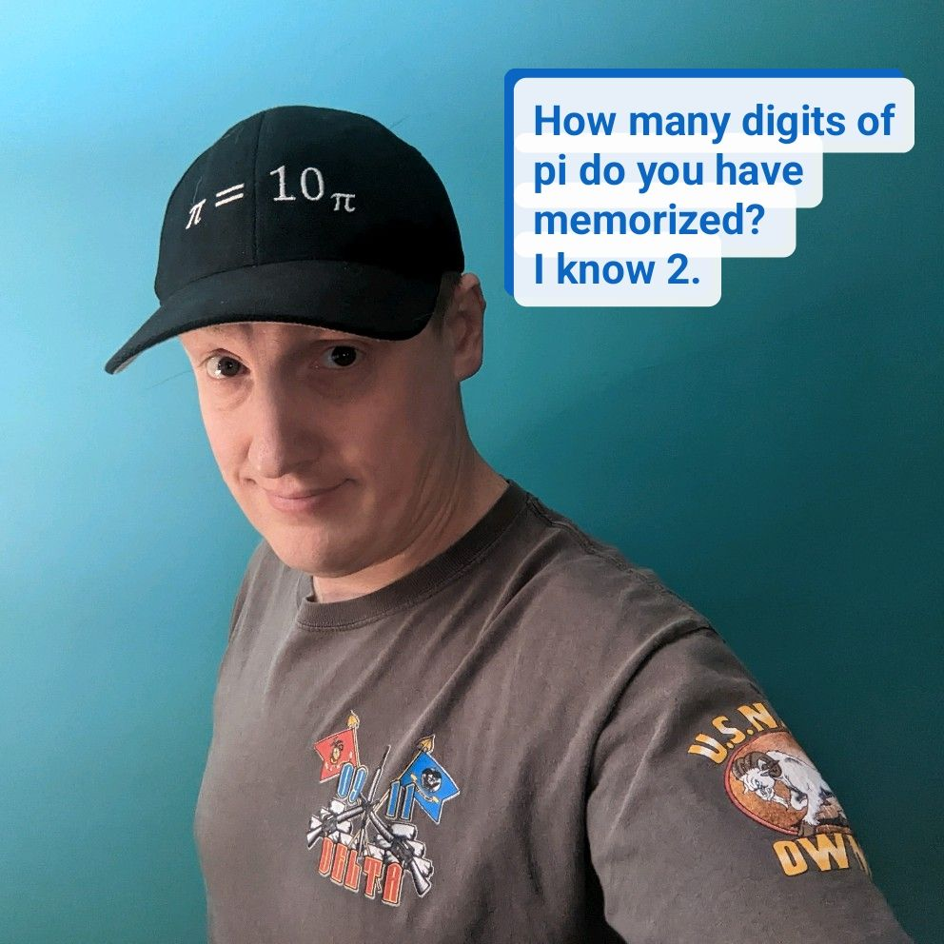
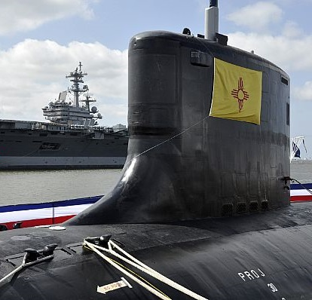
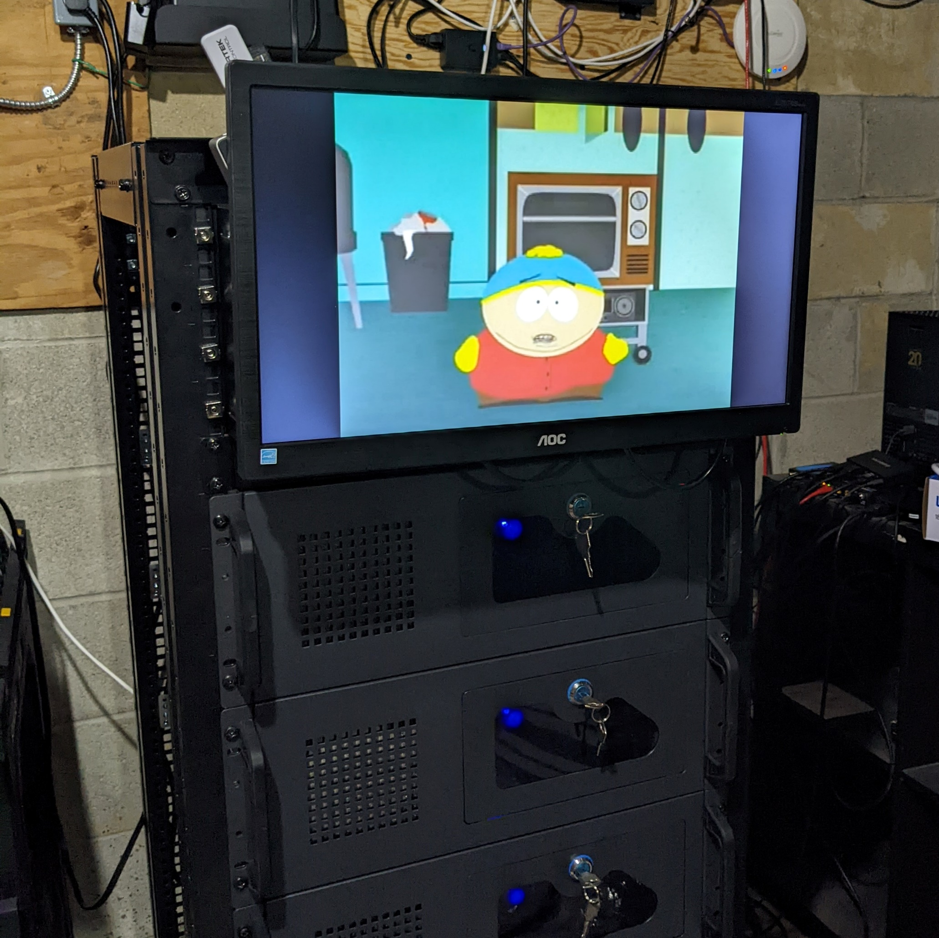
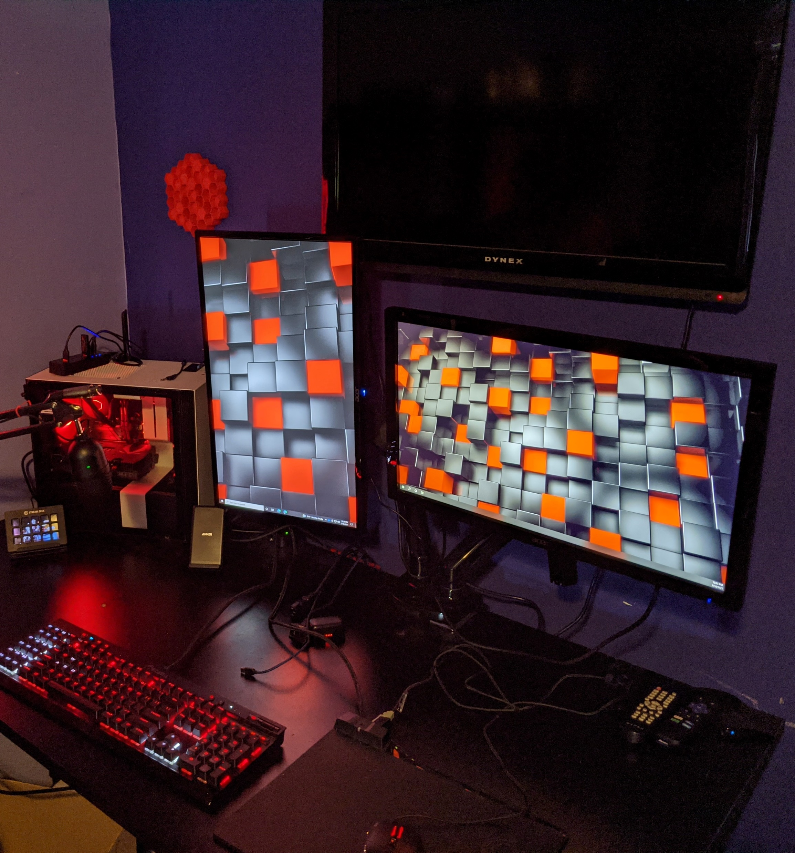
Introduction
Master Student at JHU
Cybersecurity Professional
Blue Team
US Navy Veteran
Submarine and Information Professional Officer
Hacker
Security Tool Development
CTFs
Science/Skepticism Enthusiast
Home Lab Enthusiast
Gamer
Maker

Slide 3
Overview
What is a Covert Channel?
What is the QUIC protocol?
How to craft a Covert Channel
Finding vectors in RFCs
Exploiting high-entropy vectors with encryption
Implementing the channel
Evaluating the implementation
Demonstration
Discussion
Acknowledgements & References

Slide 4
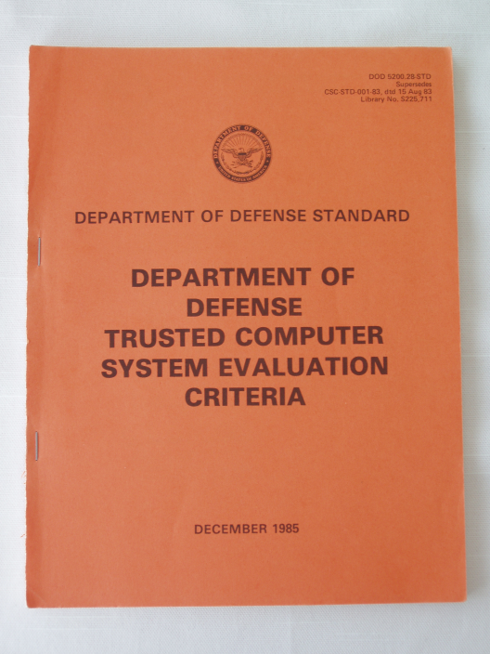
What is a Covert Channel?
A communication channel “not intended for information transfer at all, such as the service program's effect on system load” - Lampson [1]
Storage Channels
Image steganography
File headers/metadata
Network protocol header fields
Timing Channels
Crafted delays in transmission
Resource utilization dynamics
Filesystem access dynamics
Behavior Channels
Encode Information in Component/User Interactions

Slide 5
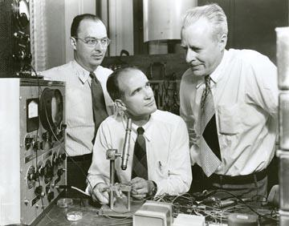
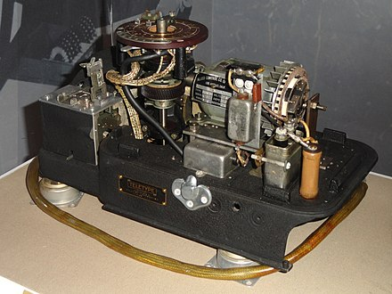
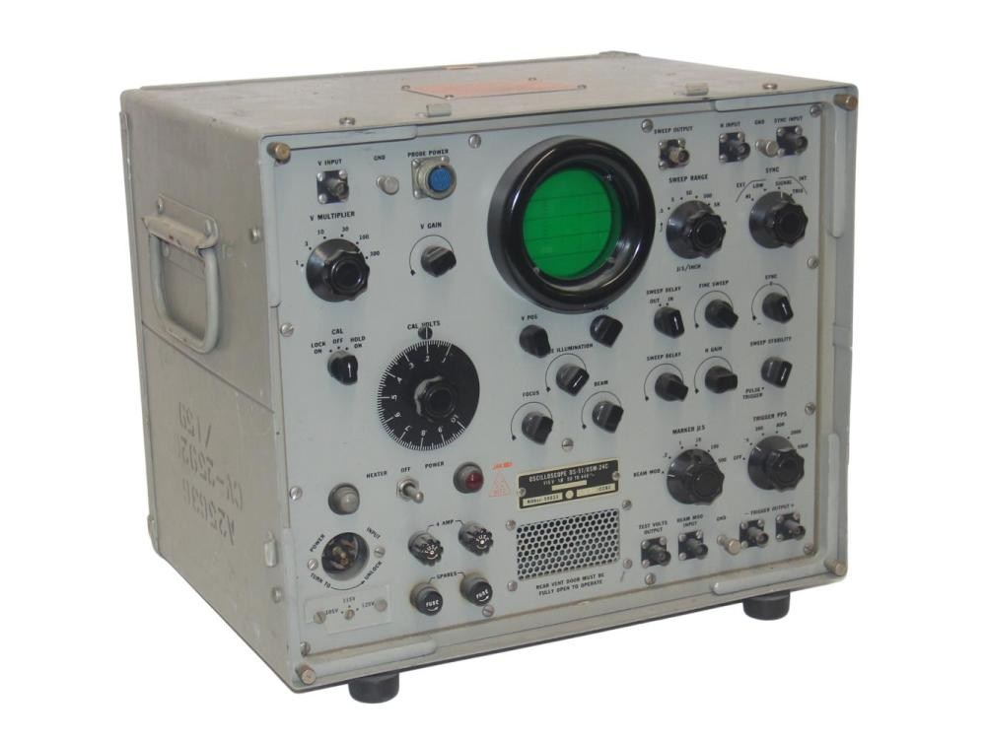
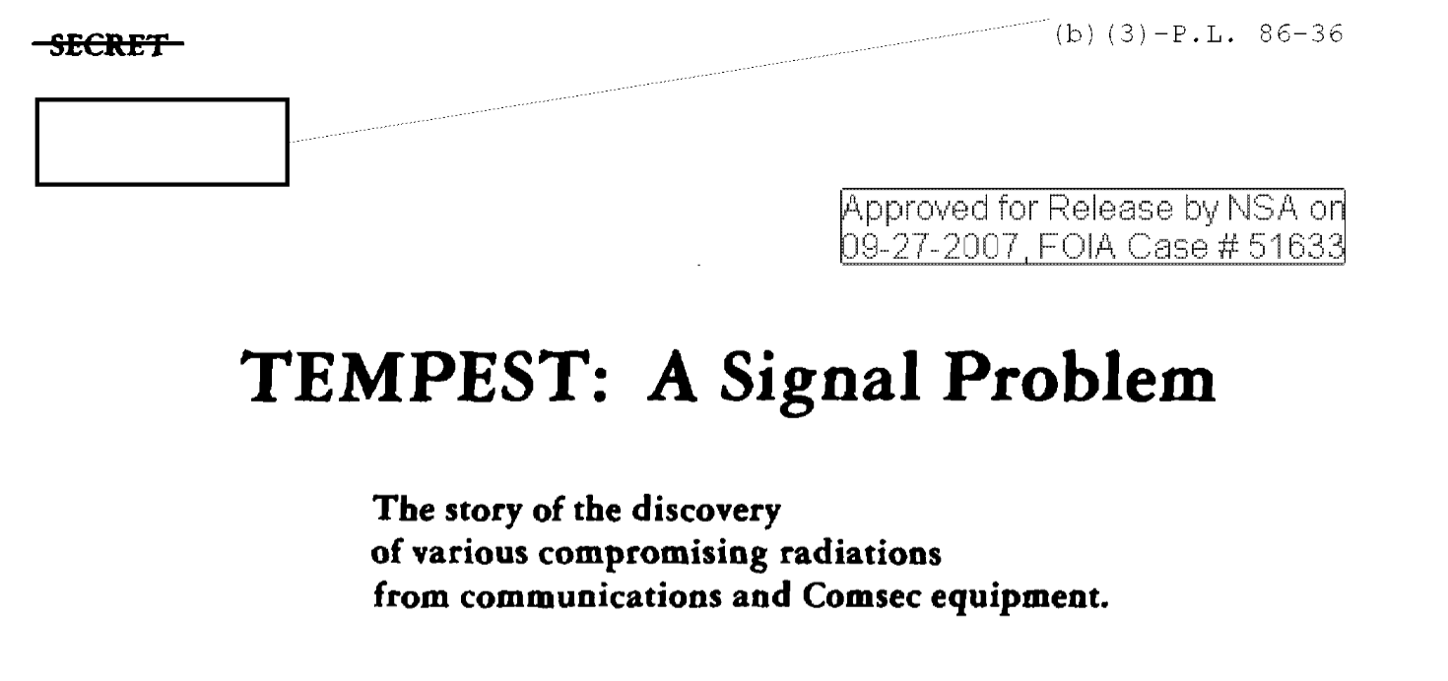
What is a Covert Channel?
Confinement Problem, 1973 [2]
Discussed by B. W. Lampson
Describes the problem of confining a program so it doesn’t transmit information to other programs
Goes back further to WWII era cryptography with the SIGTOT teleprinter resulting in the TEMPEST program in 1972 [3]
Bell Lab Researcher
Manipulate
Observe
SIGTOT
Oscilloscope
EM Channel Leakage
Notes:
Image Refs
https://www.invaluable.com/auction-lot/wwii-u-s-navy-oscilloscope-os-51-usm-24c-103-c-3bb498e920
https://westviewnews.org/2013/08/01/bell-labs-the-war-years/gcapsis/
https://en.wikipedia.org/wiki/SIGTOT

Slide 6



What is a Covert Channel?
Wendell (Warden)
Prisoner’s Problem and the Subliminal Channel, 1982 [2]
Proposed by G. J. Simmons
Prisoners
Exchange messages
Encode secret messages
Must detect manipulation
Warden
Detects
Observes (Passive)
Manipulates (Active)
Goals
Keep Messages Secret
Detect Manipulation
Resilient to Disruption
Minimize Detection
Manipulate
Observe
Alice
Bob
Covert Channel

Slide 7
What is a Covert Channel?
How to evaluate a covert channel?
TCSEC
IEEE Publications
Classification
Storage vs Timing
Risk
Bandwidth
Measured in Symbols or Bits/sec
Higher Worse
100 bits/sec considered “High”
Classification, Okhravi, et. al.
Storage vs Timing
Network vs OS vs Hardware
Value vs Transition
Risk, Wang, et. al.
Bandwidth
Weighted Difference
Threat Rate
Threat Degree

Slide 8
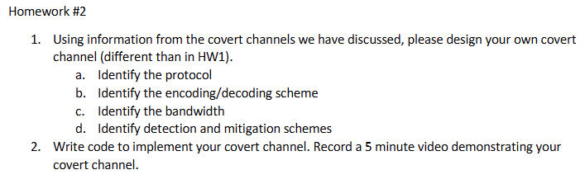
What is a Covert Channel?
Why Develop Covert Channels?
Why Did I Develop a QUIC CC?
Informs Blue Teams
Informs Risk Management
Helps Develop DLP Controls
Identifies Side-Channels
Academic Interest
Support Journalists/Whistleblowers
Wasn’t familiar with QUIC
Saw it in Wireshark and didn’t know what it was.
Passion for Encryption
Exploration of Covert Channels
(Because grades depend on It)

Slide 9
How to craft a Covert Channel
6 Easy Steps
Pick a protocol
Find out if it’s been done before
Find a vector in the protocol
Implement communication in that vector
Test it
Evaluate it

Slide 10
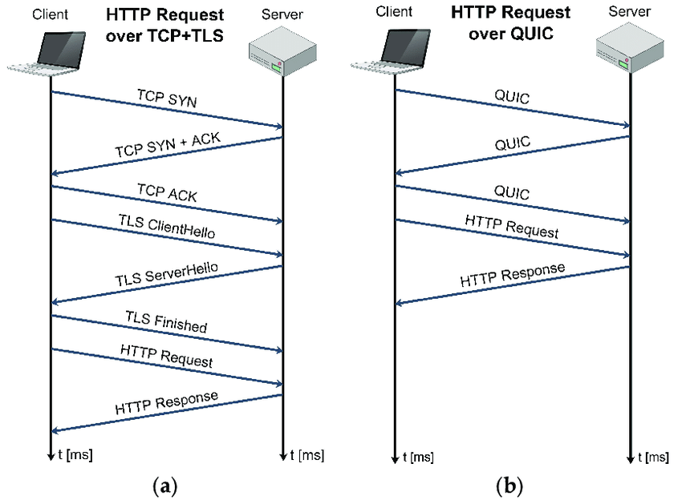
Pick a Protocol
Quick UDP Internet Connections
Proposed by Jim Roskind [1]
Defined in RFC 9000 [2]
QUIC is not an acronym
(but sure looks like one)
Combines handshake and encryption in a single step
Reduces Round-Trip-Time (RTT)
Multiplexes multiple streams over a single connection
Built-In congestion control
Image From: J. Lorincz, Z. Klarin, and J. Ozegovic, “A Comprehensive Overview of TCP Congestion Control in 5G Networks: Research Challenges and Future Perspectives,” Sensors, vol. 21, pp. 1–41, Jun. 2021, doi: https://doi.org/10.3390/s21134510

Slide 11
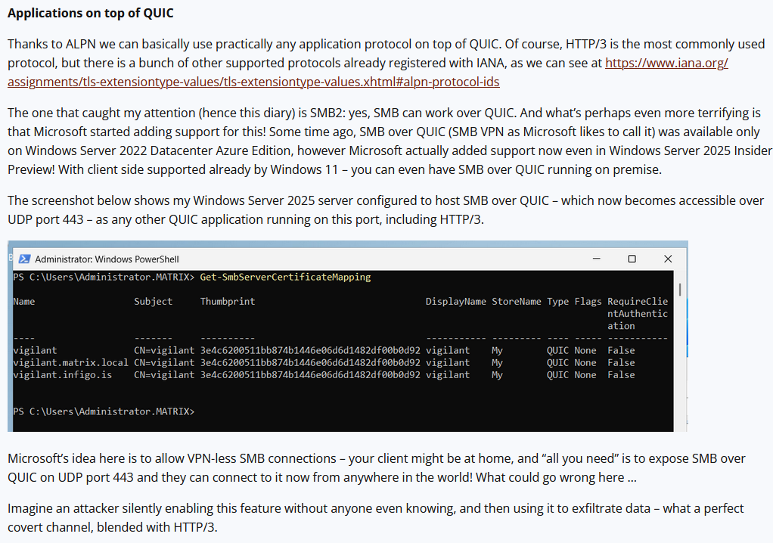
How to craft a Covert Channel
Are there existing QUIC Covert Channel Implementations?
Scanning and abusing the QUIC protocol
Author: Bojan Zdrnja
Discussed QUIC and its ALPN functions
Discussed challenges in enumerating QUIC ALPN services
Discussed Using SMB over QUIC to exfiltrate on trusted ports
Provided tool to scan QUIC services

Slide 12
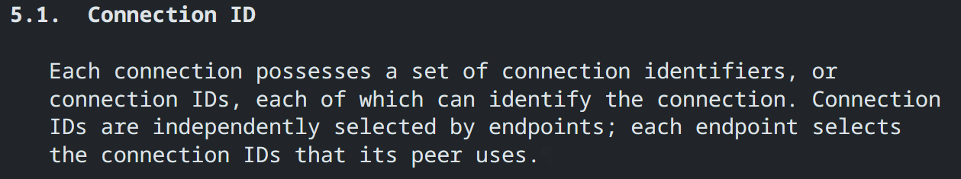
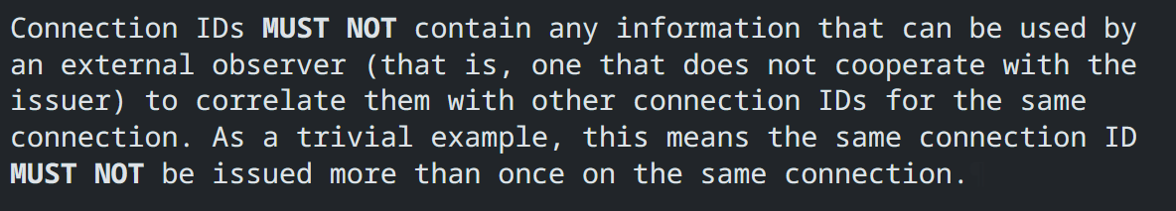
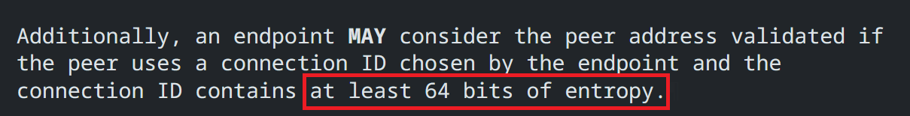
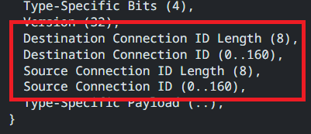
How to craft a Covert Channel
Find a vector in the protocol
Find fields with unstructured data
Find opportunities for timing channels
Find fields with high entropy
Unique IDs
Nonce’s
GREAT FOR ENCRYPTED PAYLOADS!

Slide 13
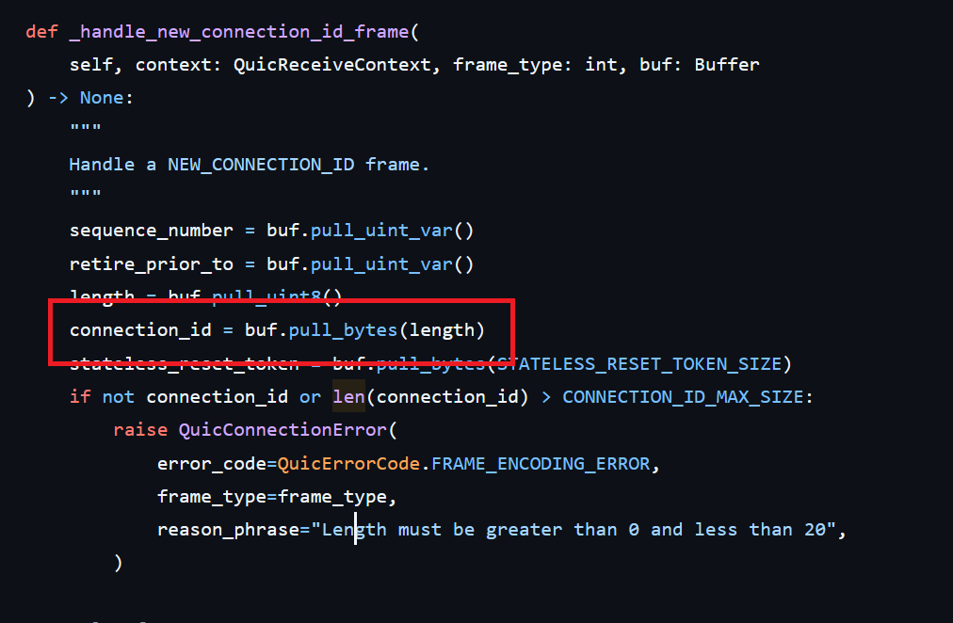
How to craft a Covert Channel
Implementing the Channel
src/aioquic/quic/connection.py
Write/Reuse Implementation
https://github.com/aiortc/aioquic
Find where target field is set
Find how it is potentially tracked or modified
Plan a protocol
TCP/IP Tunneling
Custom
(if you have a 2-week deadline)

Slide 14
How to craft a Covert Channel
Implementing the Channel – CID Queue
Message format:
m[message]
f[file bytes]
c[remote command]
k (keepalive)
Messages are queued and processed as connections are made
RSA 4096 for Asymmetric Encryption
Only public modulus exchanged
Public exponent/bit strength agreed to ahead of time
CID Generation
Create IV
Create an AES Key
Encrypt AES Key w/Private Key (Ekey)
Encrypt Message w/AES Key (Emsg)
Payload = IV + Ekey + Emsg
Chunk into 64-bit chunks
Use chunks as CIDs for new connections

Slide 15
How to craft a Covert Channel
Implementing the Channel – Send
Sent Key?
Queue Empty?
Open Connection
Y
Y
Chunk/Queue
Keepalive
New Message Queued
N
N
Chunk/Queue
Public Key
Wait for New Connection
Dequeue and Set CID
Encrypt, Chunk and Queue
Message

Slide 16
How to craft a Covert Channel
Implementing the Channel – Receive
New
Connection
Extract CID
Seen IP?
Have RSA Key?
Add CID to Buffer
Y
Y
N
N
Extract RSA Key from CIDs
Attempt Decryption of Buffer
Wait for New Connection
Success?
Queue Confirmation
Message
N
Y

Slide 17
User Operations
cwhoami
CID Queue
Server
Client
CID Queue
CID
CID
Modified aioquic operations.
Public Key
k
k
k
k
k
Public Key
mnuvious

Slide 18
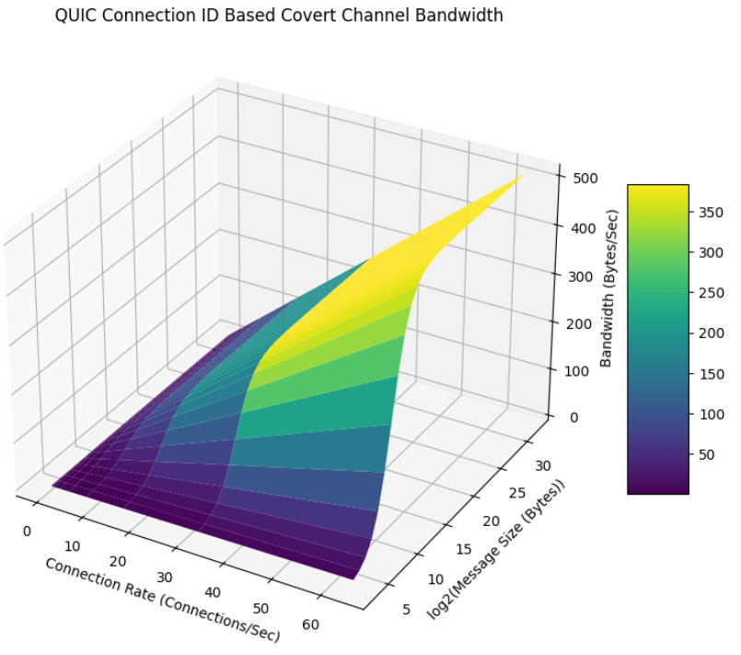
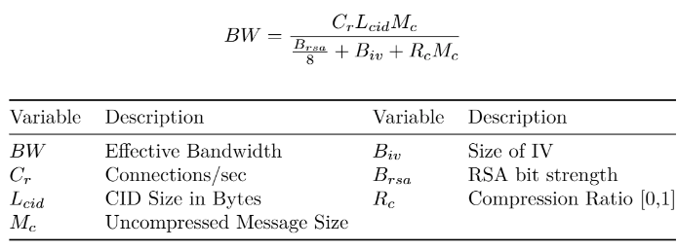
How to craft a Covert Channel
Evaluating the Channel – Bandwidth

Slide 19
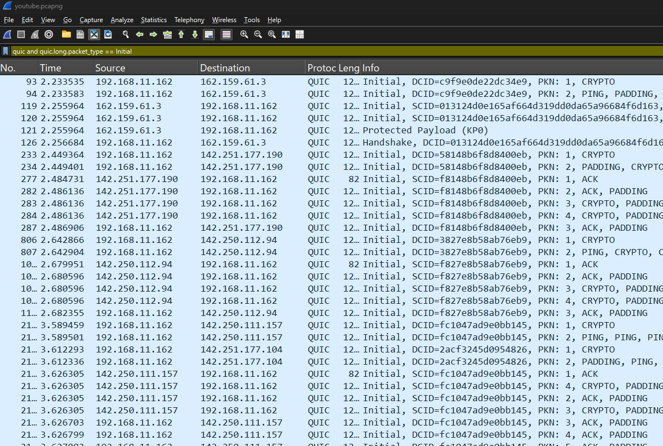
How to craft a Covert Channel
Implementing the Channel – Page Loads to Extract 4096 Bit RSA Private Key
C_{r} | 21 con / 8 sec
L_{cid} | 64 bits
M_{c} | 4096 bits
B_{iv} | 128 bits
B_{rsa} | 4096 bits
R_{c} | 1 (uncompressed)
BW | 10.3 byte/sec
Time | 49.5 sec
21 Connections with 64- and 160-bit CIDs

Slide 20
How to craft a Covert Channel
Improvement for the Implementation
Observation
High entropy data conforms to protocol spec
Can’t be observed without access to private keys
Odd-number analysis potentially reveals channel in use
Randomize big vs little endian potential mitigation
Moot if OOB key distribution is used
Manipulation
Potentially susceptible to bit-flip attacks if message format is disclosed
Otherwise without the private key, manipulation is unlikely
Disruption
Swapping out CID’s on all QUIC protocol packets would stop this channel
Costly
Dropping connections randomly to prevent 1 CID exchange would break cryptographic sync
Could be mitigated by creating cryptographic resync mechanism

Slide 21
References
[1] J. Roskind, “QUIC: Design Document and Specification Rationale,” Google-Docs, Apr. 2012. Available: https://docs.google.com/document/d/1RNHkx_VvKWyWg6Lr8SZ-saqsQx7rFV-ev2jRFUoVD34. [Accessed: Jul. 15, 2024]
[2] J. Iyengar and M. Thomson, “RFC 9000 - QUIC: A UDP-Based Mul-tiplexed and Secure Transport,” datatracker.ietf.org, May 2021. Available: https://datatracker.ietf.org/doc/html/rfc9000. [Accessed: Jul. 15, 2024]

